Slide 1
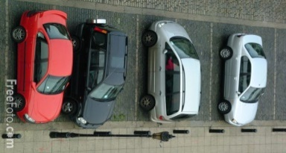
Fynbos Guest Farm
Fynbos Guest
Farm
Owl Cottage
Labyrinth
Horses
Hike 1: 1,2 km
Francolin Cottage
Donkeys
Goats
Site 5
Site 9
Emus
Site 1
Site 4
Site 6
Guinea Fowl Cottage
Sheep
Toilets
Site 2
Site 3
Camp Site 7 & 8
Goats
Pigs
Llamas/ Alpacas
Plunge Pool lapa
Children’s Jungle Gym
Main Farm House
Springbok / Ostrich
Aviaries
Hike 2: 1,6 km
Stables
Day Visitor Parking
Zebra / Springbok / Ostriches

Slide 2
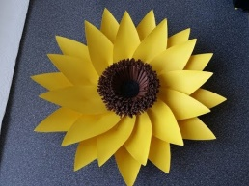
Things to do and experience in our valley of abundance
Arts & Crafts
The Creative HUB – crafts, gifts and home produce – Wolseley
Coffee Shops
Elro coffee shop – Wolseley
Things I Love - Tulbagh
Adventure & Outdoor
Horse riding– HorseAbout in Wolseley
Waterfall hike and swim – Tulbagh
The Auction House – Ceres
Tremor - Ceres
Zip Slide – Ceres
Bains Kloof mountain pass
The Crystal Cave – Tulbagh
Things I Love – Tulbagh
Elro Wood Factory & gifts - Wolseley
The Tulbagh Art Route - Tulbagh

